Slide 1
Internal Organization of Memory Chips

Slide 2
Internal Organization of Memory Chips
A memory cell is capable of storing 1-bit of information. A number of memory cells are organized in the form of a matrix to form the memory chip.
Each row of cells constitutes a memory word, and all cells of a row are connected to a common line which is referred as word line. An address decoder is used to drive the word line.
One such organization is shown in the Figure.

Slide 3
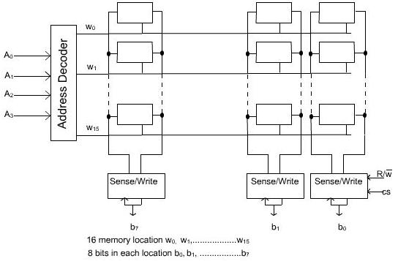
Figure : 16 X 8 Memory Organization

Slide 4
16 X 8 Memory Organization
During a Read operation, the Sense/Write circuit sense, or read the information stored in the cells selected by a word line and transmit this information to the output data line.
During a write operation, the sense/write circuit receive information and store it in the cells of the selected word.

Slide 5
16 X 8 Memory Organization
For 16 words, we need an address bus of size 4. In addition to address and data lines, two control lines, and CS, are provided.
The line is to used to specify the required operation about read or write. The CS (Chip Select) line is required to select a given chip in a multi chip memory system.

Slide 6
16 X 8 Memory Organization
At a particular instant, one word line is enabled depending on the address present in the address bus.
The cells in each column are connected by two lines. These are known as bit lines.
A memory chip consisting of 16 words of 8 bits each, usually referred to as 16 x 8 organization.

Slide 7
16 X 8 Memory Organization
The data input and data output line of each Sense/Write circuit are connected to a single bidirectional data line in order to reduce the pin required.
These bit lines are connected to data input line and data output line through a Sense/Write circuit.

Slide 8
128 x 8 memory chips:
If it is organised as a 128 x 8 memory chips, then it has got 128 memory words of size 8 bits.
So the size of data bus is 8 bits and the size of address bus is 7 bits (128 x 8).

Slide 9
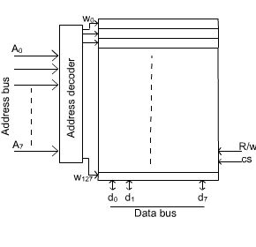
128 x 8 memory chips:

Slide 10
1024 x 1 memory chips:
If it is organized as a 1024 x 1 memory chips, then it has got 1024 memory words of size 1 bit only.
Therefore, the size of data bus is 1 bit and the size of address bus is 10 bits (2^10= 1024 ).

Slide 11
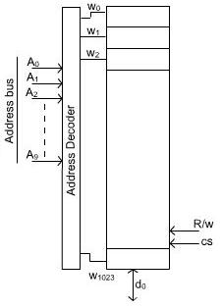
1024 x 1 memory chips:

Slide 12
1024 x 1 memory chips:
In second case, several memory words are organized in one row. In this case, address bus is divided into two groups.
One group is used to form the row address and the second group is used to form the column address. Consider the memory organization of 1024 x 1 memory chip.

Slide 13
1024 x 1 memory chips:
The required 10-bit address is divided into two groups of 5 bits each to form the row and column address of the cell array.
A row address selects a row of 32 cells, all of which are accessed in parallel.
However, according to the column address, only one of these cells is connected to the external data line via the input output multiplexers.

Slide 14
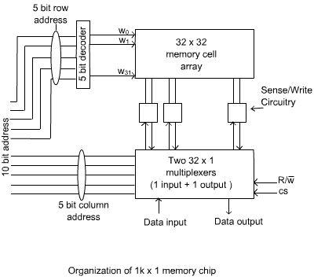

Slide 15
1M x 8 Memory Chips :
The commercially available memory chips contain a much larger number of cells. As for example, a memory unit of 1MB (mega byte) size, organised as 1M x 8, contains 2^20 x 8 memory cells.
It has got memory location(2^20) and each memory location contains 8 bits information. The size of address bus is 20 and the size of data bus is 8.

Slide 16
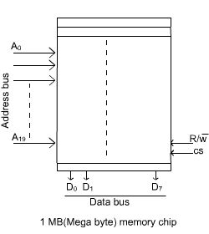
1M x 8 Memory Chips :

Slide 17


